Slide 1

Dr. Sajid Iqbal
Department of Computer Science
Bahauddin Zakariya University, Multan

Slide 2
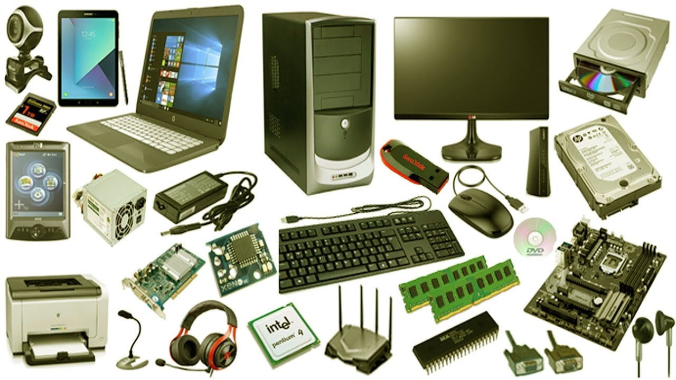
Computer Hardware
Introduction to computers

Slide 3
Types of Computers
Computer
Based on type of data processed
Purpose on Use
Size of Processing Capability
Analog Computer
Digital Computer
Hybrid Computer
General Purpose Computer
Special Purpose Computer
Mainframe Computer
Mini Computer
Micro Computer
Super Computer
Wearable Computers
Micro Comptuers
Workstations
Desktop Computer
Laptop Computer
Tablets
Mobile Computer
Embedded Computers

Slide 4
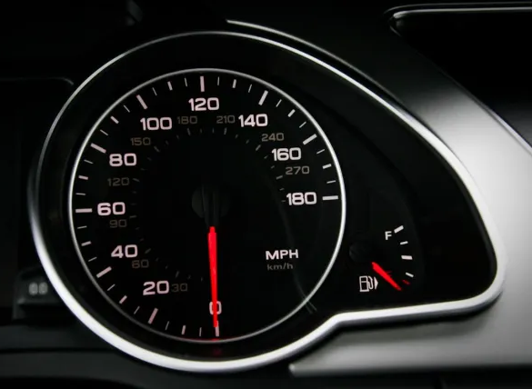
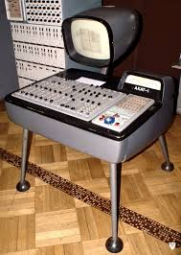
Analog Computers
A computer that can handle the analogue data and process
Analog computers can have a very wide range of complexity
Applications like flight simulators are done using analog computers
These can only represent physical quantities such as pressure, weight, voltage pressure, speed, and more
The output of analog computer are usually shown on a graph
Some main features are
Continuous values
Small memory
Slow speed
Not as reliable
Results are not accurate
Difficult to use

Slide 5
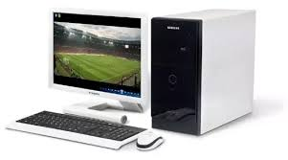
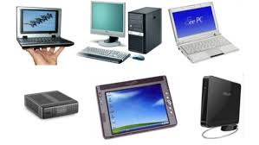
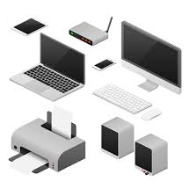
Digital Computers
The information is represented in the form of digits
Such systems can perform arithmetic operations with ease, and in most instances, much faster than the human brain
Some main features
Discrete values
Large memory
Faster speed
Very reliable
Results are 100 percent accurate

Slide 6
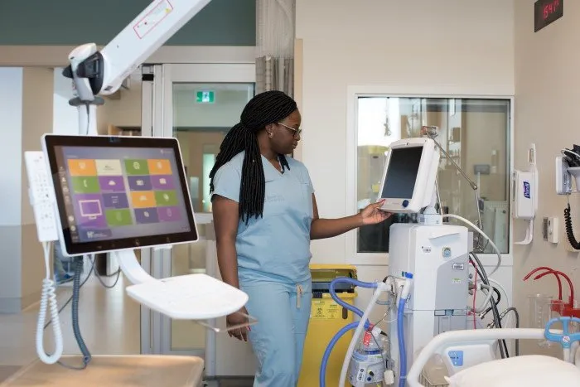
Hybrid Computers
A blend of analog and digital computers
They are specialized applications that need to process analog and digital information
There are number of applications of hybrid computers
Example: System in intensive care unit

Slide 7
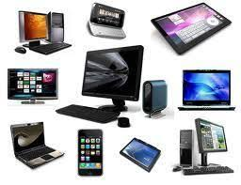
General Purpose Computers
A digital computer that is used to solve a wide range of problems that may include
Scientific, technical and economic
All mainframes, servers, laptop and desktop computers, as well as smartphones and tablets are general-purpose devices.

Slide 8
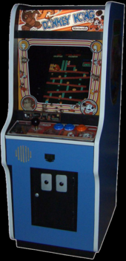
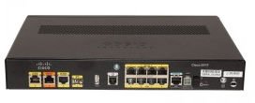
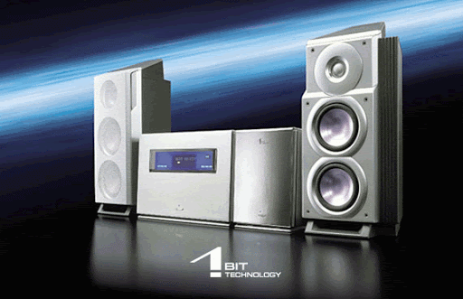
Special Purpose Computers
The computers which are built to perform specific task
Examples include
Graphic intensive gaming stations
traffic lights control system
navigational system in an aircraft,
weather forecasting,
satellite launch / tracking,
oil exploration
…

Slide 9
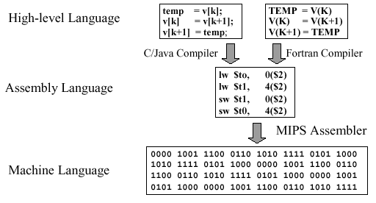
Computer Performance
Performance of general computer is normally measured in terms of instructions it executes in a second
Million instructions per second (MIPS) is the normal unit of performance measurement
The count is about the machine instructions, not the high level instructions
However different instruction can take different time
i.e. addition may take 2 cycles and multiplication may take 4 cycles
Computers performing scientific tasks usually deal with real numbers
Operation performed with real numbers is called the floating point operations
Performance of a computer doing scientific task is measured in Floating Point Instructions per Second (FLOPS)

Slide 10
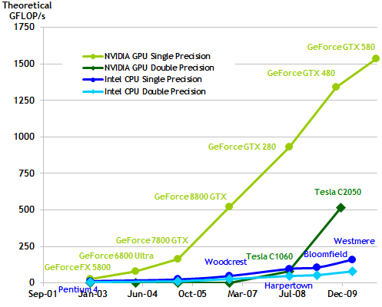
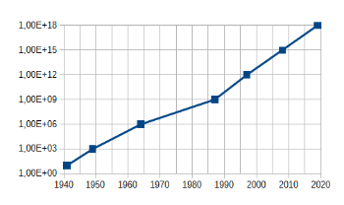
Performance of Computers
Computer performance evolution over time
Courtesy: study.com

Slide 11
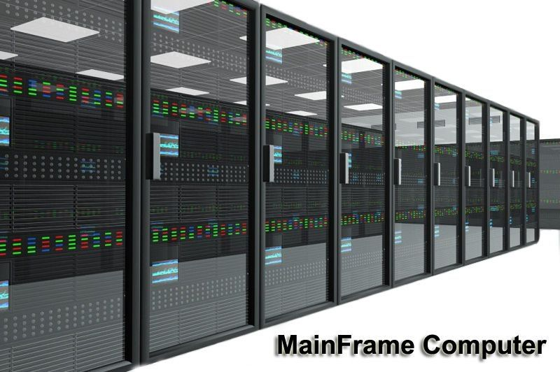

Mainframe Computers
These are computers used primarily by large organizations for critical applications like
Huge data processing, such as census
Industry and consumer statistics
Enterprise resource planning (ERP)
transaction processing
They are larger and have more processing power than
minicomputers, servers, workstations, and personal computers
They cost higher than other computers

Slide 12
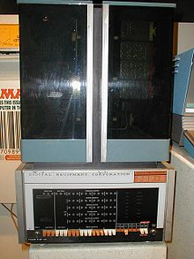
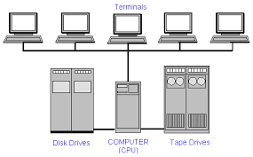
Mini Computers
Class of smaller computers that was developed in the mid-1960s
The class formed a distinct group with its own software architectures and operating systems
Minis were designed for control, instrumentation, human interaction, communication switching , and record keeping

Slide 13
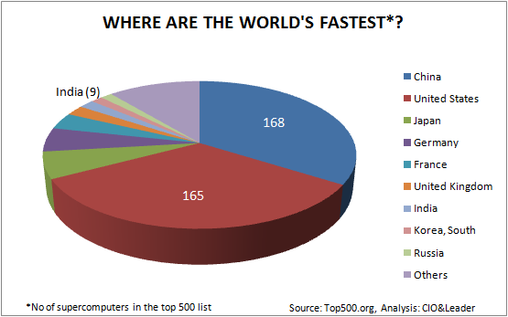

Super Computers
There is no specific definition of super computer
It is a computer with a high level of performance as compared to a general-purpose computer.
There are supercomputers which can perform over ${10}^{17}$ FLOPS
Supercomputers play an important role in the field of computational science

Slide 14
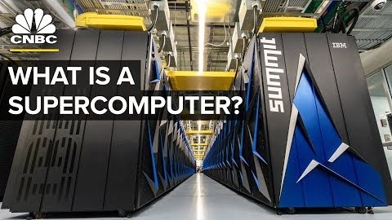
Super Computer
Courtesy: CNBC YouTube channel

Slide 15
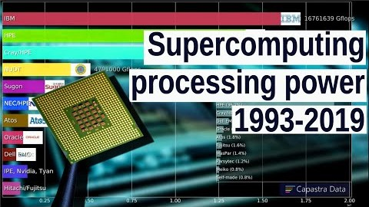
Super Computer Processing Power
Courtesy: Capastra Data YouTube Channel

Slide 16
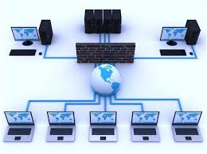
Server Computers
Server: A computer that provides “service” to other computers
A server may be either software program or hardware machine or combination of both
Client: A computer that receives “service” from server computer
This type of arrangement is called the client-server architecture
Service: A functionality provided by a computer
File service
Email service
Web service
Database service
Usually a server computer has more resources like RAM, processing power and storage.

Slide 17



Thanks for watching
Dr. Sajid Iqbal
Assistant Professor
Department of Computer Science
Bahauddin Zakariya University, Multan
sajidiqbal.pk@gmail.com
https://github.com/sajjo79/Introduction-to-Computers
Allah Hafiz
COMEDXD

